Slide 1

Bike Sharing Demand Analysis
Understanding rider behaviour through weather, time and demand patterns
NextHikes IT Solutions
Submitted BY
MD SHAHNSHAH

Slide 2
Project Overview
1
Who rides
Split between casual and registered users
🎯
Objective
2
When they ride
Analyse hourly bike-share usage to understand what drives rider demand, and turn that into decisions the business can act on.
Weekday vs weekend, and time-of-day demand
3
What affects demand
Weather condition and temperature band
📊
Scope
4
Where it's heading
Rider volume, weather & temperature effects, day-type and hourly patterns, and growth trend over the observed period.
Trend direction across the 45-day window
2

Slide 3
About the Dataset
1,000
45
24
3
Hourly records
Calendar days
Data columns
Source files merged
Coverage window: 1 January 2011 – 14 February 2011
Core fields captured per hour:
Date & Hour · Season, Weather, Temperature, Humidity, Wind Speed · Casual, Registered & Total ride Counts · Holiday & Weekday flags
Note: this dataset is an early 45-day sample — not the full annual dataset, so trends should be read as an early signal, not a full-year conclusion.
3

Slide 4
Workflow
1
2
3
4
Merge
Clean
Engineer
Enrich
Three raw source datasets combined into one unified table
Dates, headers and data types standardised across the sheet
New readable fields built: Season_Name, Weather_Name, DayType
Added Time_Slot, Temp_Types (Cold/Mild/Hot) and Holiday_Status
Result: a single, analysis-ready table (“FinaL_Data_Set”) driving every pivot table, KPI and slicer in the workbook.
4

Slide 5

Key Performance Indicators
58.3K
4.9K
53.3K
58.3
Total Rides
Casual Riders
Registered Riders
Avg. Rides / Hour
Registered (subscriber) riders account for the large majority of total volume — see split on the next slide.
5

Slide 6
Casual vs Registered Riders
91.6%
of all rides come from Registered users
8.4%
comes from Casual, pay-per-ride users
Insight: demand is driven mainly by regular commuters, not one-off riders — retention matters more than acquisition.
6

Slide 7
Weather Impact on Ridership
64%
of all rides happen in Clear weather
Heavy rain / snow all but stops ridership — only 36 rides recorded.
7

Slide 8
Weekday vs Weekend Demand
💼
Weekdays lead demand
Average hourly rides are highest on weekdays (63.3), pointing to a strong commuter pattern.
🏖
Weekends are quieter
Saturday and Sunday run 25–26% lower per hour — likely more leisure, fewer commutes.
8

Slide 9
Time-of-Day Demand Pattern
Peak hours
5–6 PM · 8 AM
These hours line up with typical commute times, reinforcing that most riders use the service to get to and from work.
Night hours (10 PM–5 AM) see minimal activity, under 2,000 rides across the whole period.
9

Slide 10
Temperature Impact on Ridership
+68%
Higher average ridership in hot conditions vs cold
Warmer temperatures consistently correlate with more rides per hour — comfort clearly drives casual and commute usage alike.
10

Slide 11
Growth Trend Across the Period
Linear trend, 1 Jan – 14 Feb 2011
All up.
Every rider segment trends upward over the 45-day window — Casual growing fastest, Registered close behind.
Trend is based on a best-fit line across all 45 days, not just first-day-vs-last-day, so single-day spikes don't distort it.
12

Slide 12
What Drives Ride Count?
Reading the Count vs Temp / Humidity / Wind Speed scatter charts
T°
Temperature
Positive relationship — rides trend up as temperature rises across the range observed.
💧
Humidity
Weak negative relationship — very high humidity days tend to show lower ride counts.
💨
Wind Speed
Mild negative relationship — higher wind is associated with modestly fewer rides.
Takeaway: temperature is the strongest single weather driver of demand — humidity and wind matter far less.
11

Slide 13
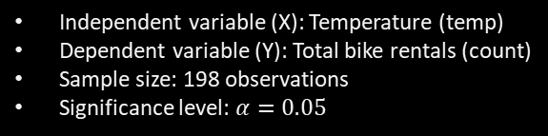
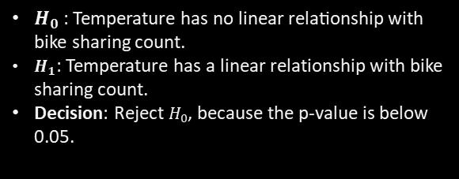
ANOVA & Simple Linear Regression
To examine whether temperature has a statistically significant linear relationship with daily bike sharing counts.
Methodology
R-squared
Significance F
Independent variable (X): Temperature (temp)
Dependent variable (Y): Total bike rentals (count)
Sample size: 198 observations
Significance level: $α=0.05$
80.72%
5.47 × 10⁻⁷²
Variance explained
p-value below 0.05
Regression Equation
Count= −19.227+166.849(temp)
Hypothesis Testing
F-statistic
Regression slope
820.69
166.85
$H_{0}$​: Temperature has no linear relationship with bike sharing count.
$H_{1}$: Temperature has a linear relationship with bike sharing count.
Decision: Reject $H_{0}$, because the p-value is below 0.05.
Overall model test
Per 1°C increase
Temperature is a statistically significant predictor of bike sharing demand in this sample. The SLR model explains approximately 80.72% of the observed variation in sharing counts. Other factors and unexplained variation may still affect demand.

Slide 14
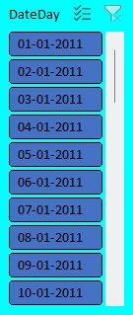
Interactive Dashboard
📊
KPI Cards
🔍
6 Slicers
13

Slide 15
Key Insights
1
Registered subscribers drive 91.6% of all rides — the business runs on commuters, not one-off users.
2
Clear weather accounts for 64% of ridership; heavy rain/snow almost eliminates demand.
3
Weekdays average 63.3 rides/hour vs ~48 on weekends — a clear commute-driven pattern.
4
Two daily peaks — 8 AM and 5–6 PM — mirror standard office commute times.
5
Warmer temperatures lift average hourly ridership by roughly 68% versus cold conditions.
6
All rider segments (Casual, Registered, Total) trend upward across the 45-day window.
16

Slide 16
Recommendations
1
Protect peak-hour capacity
Ensure bike availability at 8 AM and 5–6 PM when commuter demand is highest.
2
Grow casual-to-registered conversion
Casual riders are a small share of volume — target them with subscription offers.
3
Plan around weather
Use forecast data to pre-position bikes ahead of clear-weather days and reduce ops on heavy-rain days.
4
Re-check trend with full-year data
This 45-day sample shows upward growth — validate against a complete annual dataset before committing budget.

Slide 17
Thank You

